Slide 1
An n-Tiered Model of Sub-Atomic Structure
Aran David Stubbs
The Inframatter Research Center
http://inframatterresearchcenter.org/
APS Conference March 2014

Slide 2
Outline
Outline
Layers
Atom
Nuclei
Quarks, Di-quarks, & the like
Proto-matter
Gravitons & Infra-matter
Angular Momentum
Charge & Color
Eccentricity
Assumptions
Conclusion

Slide 3
Layers
Molecules
Bound by electric forces
Comprised of Atoms
Atoms
Bound by electric forces
Comprised of Nuclei & Electrons
Nuclei
Bound by nuclear forces
Comprised of Quarks, Di-quarks, and a photon-like shell, with a crystalline structure
Quarks, Di-Quarks, Leptons, Photons & the photon-like shell
Bound by nuclear forces
Comprised of Proto-matter & gravitons, mostly in s-orbits (some in shell not s)
Count of proto-photons = 3|z|
Proto-matter
Comprised of Mezzo-matter or Infra-matter in s, p, and sometimes other orbits
Mezzo-matter
Comprised of Infra-matter in s orbits (for charge bit), or s & p (for color bit)
Infra-matter

Slide 4
Atom
Comprised of Nuclei & electrons
Neutral atom has z electrons, but it can easily be ionized
By default, electrons occupy orbit with lowest high point, but can easily be excited into a higher orbit
Eccentricity of electron orbit
This gives a high point of
This pattern matches the standard pattern through 7p, after which 5g precedes 8s.
High l orbits are inserted within the standard pattern frequently after that: h between d and p, i between f and d, j between g and s, etc.
An Electron may be added to next s sub-shell to minimize variability in angular momentum. Pairs or a half-shell have constant L

Slide 5
Nuclei
Comprised of Quarks, Di-quarks, and a photon-like shell
Zero net color, but z net charge
Photon-like shell has 3z proto-photons
Typically these are a body centered cubic crystalline structure with an octahedral surface
Small nuclei have a block structure
Very large nuclei have a surface intermediate between octahedral and spherical: a “fluffy” octahedron
Fluffiness serves to minimize difference in charge radius
All charge is at the surface, where a surface sphere is one with less than 6 neighbors
Interior consists of down quarks and up/down di-quarks
Surface is mostly up quarks and up/down di-quarks with a few down quarks distributed to minimize dipole
Each has a single color scheme (red with blue-green shown below), and can only fuse with a nucleus of the same color scheme

Slide 6
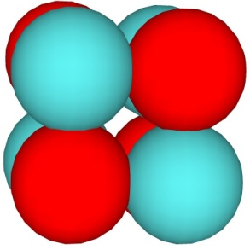
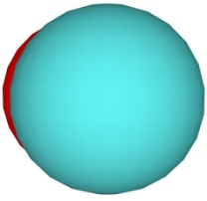
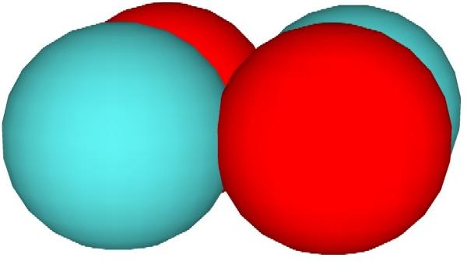
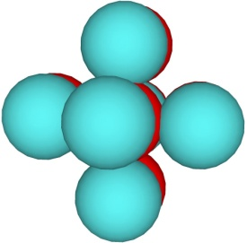
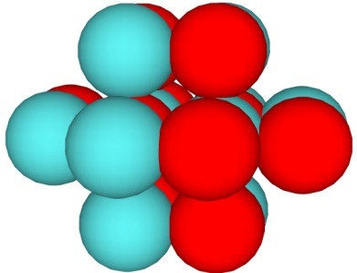
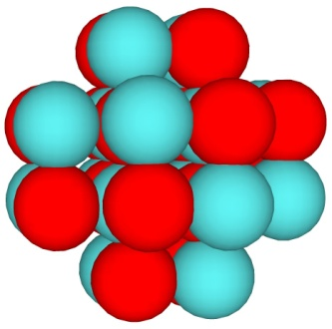
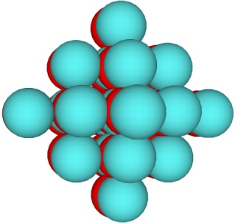
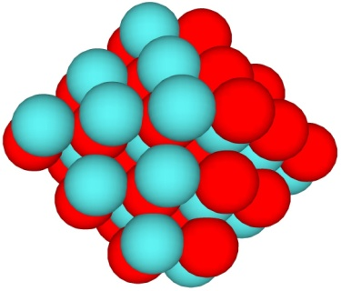
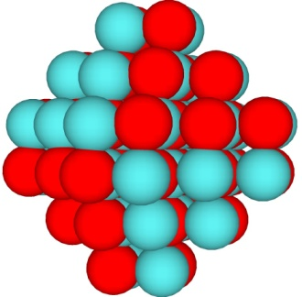
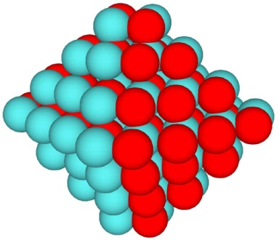
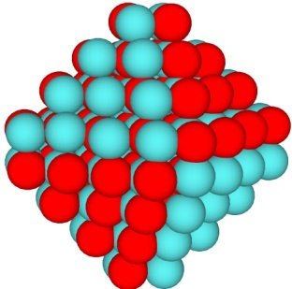
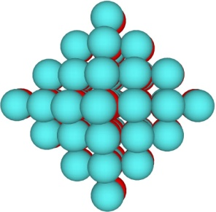
Sample Nuclei
2x2x2: He-4
1x1x2: H-1
1x2x2: H-2
L1
Li-6
B-10
O-16
L2
F-19
Si-28
Ca-40
L3
Ni-60
Kr-80
L4

Slide 7
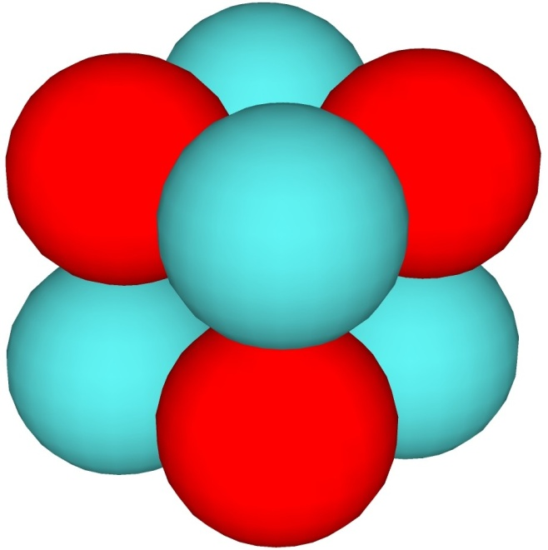
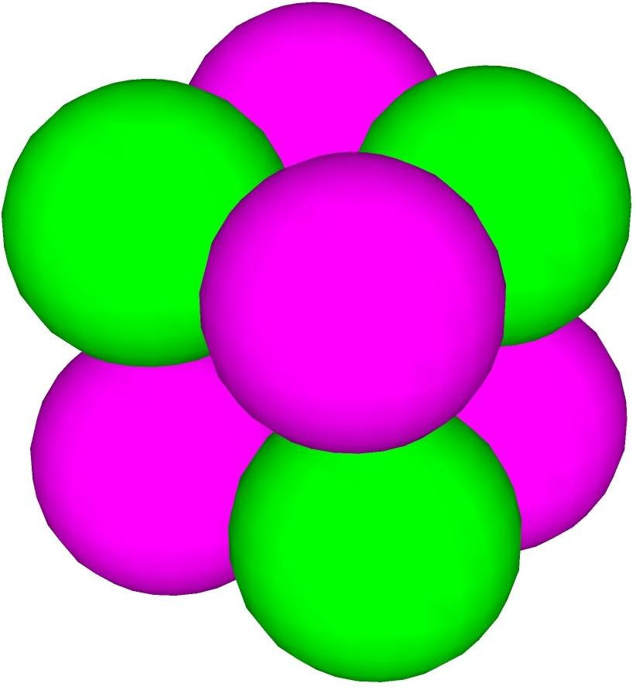
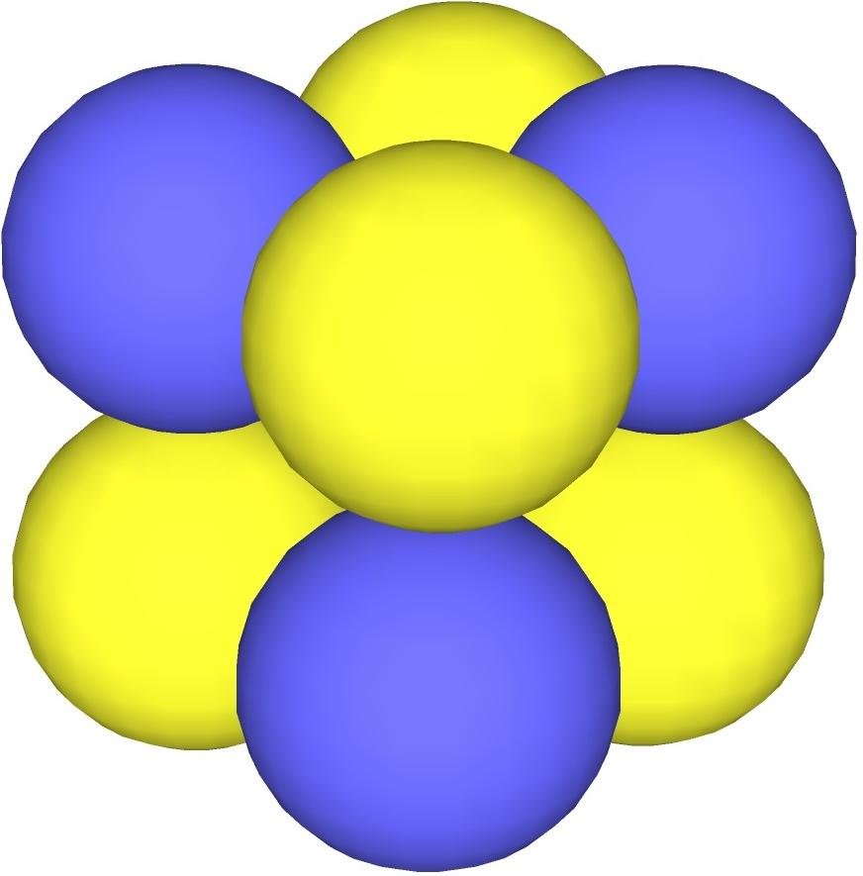
Color Schemes
Red quarks, blue-green diquarks
Green quarks, red-blue diquarks
Blue quarks, red-green diquarks

Slide 8
Quarks & Di-Quarks
Comprised of proto-matter & gravitons
In the wild each has net color and net charge, so very high energy
Di-quarks have 2 proto-quarks, 2 proto-pions, 2 gravitons, & 0-4 proto-photons
Quarks have 1 proto-quark, 1 proto-pion, 2 gravitons & 0-2 proto-photons
In the nucleus, there are up/down di-quarks, each containing a proto-up & a proto-down
Other combination di-quarks occur in other baryons (up/up or down/down in the delta, for example)
In the wild, or matched to a down quark, or interior to a nucleus, an up/down di-quark has 1 proto-photon
The down (or strange or beauty) quark has 1 proto-photon
In the wild, the up (or charm or truth) quark has 2 proto-photons
The proto-photons for surface up quarks and di-quarks get promoted to the photon-like shell

Slide 9
Other “Elementary” particles
Each consists of proto-matter and gravitons
Charged leptons have a proto-lepton, 2 gravitons, and 3 proto-photons
Photons have 2 (1s) gravitons and 4 proto-photons (2 2s, 2 3s)
Neutrinos have 2 gravitons and 2 proto-photons, in un-matched sub-shells (-2s and +3s for an electron-neutrino)
The photon-like shell surrounding nuclei has 3z proto-photons
These are typically in the lowest energy orbit
A piece of proto-matter requires a graviton in a similar orbit (one with the same eccentricity) to be held in place
The 1s orbits are occupied by gravitons, supporting all the other s orbit proto-matter

Slide 10
Proto-Matter
Comprised of Mezzo-matter or Infra-matter
Held together in “elementary” particles by gravitons orbiting just below
Each has inherent angular momentum as the result of charge and sometimes color, but can also have orbital angular momentum (typically opposed to inherent direction)
In simple structures (such as leptons & photon), they have rational velocity relative to light to produce integer angular momentum
In complex structures (such as baryons & mesons), the combination has integer angular momentum but individual pieces need not
Many types predicted:
Proto-photon (2 flavors: trivially + and trivially -; that cling to opposing charge)
Proto-pion (6 flavors: trivially + and trivially - of red, blue, or green; that cling to opposing color)
Proto-lepton (6 kinds predicted, corresponding to the 6 known charged leptons)
Proto-quark (12 kinds predicted, corresponding to the 12 known quarks). Each has integer amounts of net color, while the proto-leptons have none.

Slide 11
Gravitons, Mezzo-Matter, & Infra-Matter
Mezzo-matter bits are tardyons, structures containing Inframatter: some are charge related some are color
Inframatter is treated as lowest level
Inframatter has no real rest energy
Some Inframatter are tachyons, some are luxons.
Luxons trap tachyons in orbit just below them, as their length from the tachyon’s perspective is L_{v}=L₀iv/c, when that length is greater than the tachyons wavelength
Tachyons attract luxons, but are repulsed by them
The Graviton is a tachyon, moving much faster than c (about 4*10²³ c in electron). Velocity varies directly with wavelength, inversely with E
5 types of Inframatter likely:
Gravitons, Charge Tachyons, Color Tachyons, and infra Tachyons
Infra-photon luxons

Slide 12
Angular Momentum
Structures normally have integer angular momentum, in terms of ħ/12c as a small unit
A proto-photon or proto-pion in an n-s orbit has +/- n small units of angular momentum, dependent on orientation
The angular momentum of the proto-electron in the wild is -7 small units
The proto-electron has the energy of the Electron as rest energy, and is travelling at c in a +2s orbit. It has kinetic energy of the energy of the Electron and +3 small units of orbital angular momentum. This is offset by the matching 2s proto-photon with -2 small units, giving the Electron as a whole -6 small units of L
The Muon has a proto-muon in a 3s orbit travelling c matched to a proto-photon in a 4s orbit, while the Tauon has a proto-tauon in a 4s orbit at c matching a 4s proto-photon. Each also nets -6 small units of L

Slide 13
Charge & Color
Tachyonic charge bits in s orbits produce angular momentum on the z-axis, which we interpret as charge
The non-tachyonic bits (charge, color, or infra-photon) produce only trivial angular momentum (about 10⁻²⁴ the matching tachyon’s amount)
As the product of energy and velocity is nearly constant for a tachyon, unless moving quite slowly, the n-s orbits all produce the same amount of angular momentum per type of tachyon
The proto-electron has charge tachyons in -1s, -2s, & -3s orbits, producing a combined angular momentum of -7 small units
Tachyonic color bits in p orbits produce angular momentum in 1 of 6 directions perpendicular to the z-axis that we interpret as color
Since the L vectors from the p-orbits are 60˚ apart, a red vector plus a blue vector add to an anti-green vector, for instance in a di-quark
Higher l orbits produce Strangeness, then the other attributes of the heavier quarks. Strangeness corresponds to a full d sub-shell, not net angular momentum from an unmatched vector

Slide 14
Eccentricity
As with the orbits of the electrons, the orbits of the mezzo-matter and infra-matter bits have an eccentricity of
This produces variable angular momentum for each bit in a p or higher l orbit
p-orbits can mutually reinforce, since the sum of a red-vector and a blue-vector are the same magnitude as either on average, and can be combined with an anti-green vector to produce constant angular momentum. This holds for any consecutive trio of this group’s vectors
Higher l orbit vectors cannot reinforce, so net Strange (Charm, etc) is not observed. The Strange proto-quark has 5 vectors from the tachyons in the 3d sub-shell 72˚ apart, cancelling out to 0 (and 5 luxon vectors ditto). It also has 5 occupied s orbits, and 4 occupied p orbits, with net color in 1 of the p sub-shells, and net charge from 1 of the s sub-shells.

Slide 15
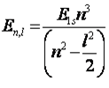
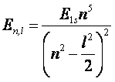
Eccentricity (cont)
The mean Energy of each luxon is
The mean Energy of each tachyon is
Tardyons have a more complex general solution, but act like the luxon case if velocity is constant
In each case the energy of a 1s bit is typical for the type of bit
(~4 KeV for a charge bit, ~1 MeV for a color bit)
In most cases, a sub-shell is filled with ½ the bits as tachyons and ½ as luxons or tardyons
Combining either equation with l=0 gives a simpler formula for the n-s bits of E_{ns}=nE_{1s}

Slide 16
Assumptions
All Tardyons (any object moving slower than the speed of light) are structures, and all structures are tardyons. “Structure” as used here means anything with constituents, but that can be treated as a whole. By contrast, “in the wild” means not in a larger structure.
The fundamental forces of electro-magnetism, gravity, and the strong force are the result of wave on wave refraction. This slows the wave causing an attraction for the tardyons, and a repulsion for the tachyons.
Tachyons become trapped in structures when L_{v}>λ. The L_{v} in question is the length from the tachyon’s perspective of the orbiting tardyons with L_{v} ~L₀ V/c, where V (the velocity difference of the 2) >>c.
Centripetal force is 2E_{k}/r for all types. Where V is small, this reduces to mV²/r.
The granularity constant h relates the total energy of a photon to its frequency. The standard form E=hν only applies for the photon. The individual pieces follow a more general law E=hc/λP*, where λ is the wavelength, and P* is the number of energy equivalent pieces in a photon (12). This E is the kinetic energy. This form holds for the immediate constituents of each of the elementary particles.
This granularity constant is generated by the gravitons within the structure.
Other granularity constants are generated by other tachyons.
Kepler’s laws are only applicable in a Newtonian framework. Where V is large, a more general form using energy is required. For an electron in isolation near a charge, the first stable 1s orbit occurs where r = a₀/z, where z is the ratio of the charge on the structure to the charge on a proton, a₀ is Bohr’s radius, and r is the distance between the centers of mass of the structure and the electron. The Kinetic Energy of the orbits of the charged structure and the electron total z²E₁ where E₁ is the energy for z=1. Distance from the center of mass to each is proportionate to the total energy of the other (rest + kinetic). Velocity is derived, not proportionate to z. For many cases z is a net charge, often symbolized as z*.
The infra-matter luxons in s orbits are synchronized to the gravitons, having 1 orbital cycle in the time a graviton has m (an integer >3).
The electrons have eccentric orbits, aside from the s, with focal length f proportionate to l number. P (l=1) has f of 1s radius /√2 so 2p has eccentricity e of √2/4, 3p has e of √2/6, etc. D (l=2) has twice the focal length of P, so 3d has e of √2/3. Similarly, the proto-matter and infra-matter have orbits with equivalent eccentricity.

Slide 17
Conclusion
While highly speculative, this gives a framework for re-examining fundamental structure
It gives specific, measurable differences in behavior from the standard model
Actual velocity of light < c (very slightly: 2 parts in 10⁴² at 1 eV)
Maximum charge on nucleus < Dirac’s limit (about 134 instead)
Electron orbits fill in a different sequence from element 119 up
2s and 2p orbits slightly different in energy
Net charge of each nucleus entirely at the surface
Free quarks extremely high energy
Many higher l quarks possible, but may not hadronize quickly enough to see
No Gluons: proto-pions instead, which are never found in the wild
This theory quanticizes the graviton
It gives an explanation for a cyclic universe: burning baryons at the minimum diameter into dark matter, causing a bang whenever the concentration gets too high, with each cycle having less baryonic matter leftover than the previous cycle

